Slide 1
Mastering LLD & OOPS in C++:
Primer and OOPS in C++

Slide 2
The Big Picture of Software Engineering

Slide 3
Understand the processes of Tech Teams

Slide 4
There are lot of buzzwords in the Industry…

Slide 5
Instead of terms … focus on Roles and it Processes …
Main processes that happens in a big tech company:
Decisions on what to be built next as a feature/product.
Jotting down the Product Requirements for the feature.
Creating the UI/UX for the product.
Letting down the Tech Design Docs for the product.
Actually coding the feature with proper tests.
Launching that product in stages.
Do a final review and close the cycle.

Slide 6
Instead of terms … focus on Roles and it Processes …
Main processes that happens in a small tech startup:
Decisions on what to be built next as a feature/product.
Break it into backend and frontend
Actually coding the feature with proper tests.
Launching that product.
Quickly Re-iterate if needed.

Slide 7
Roles that exist in the Software Engineering Realm.
Software Engineer
Product Manager
Engineering Manager
UI/UX Designer

Slide 8
HLD and LLD, what is the difference?

Slide 9
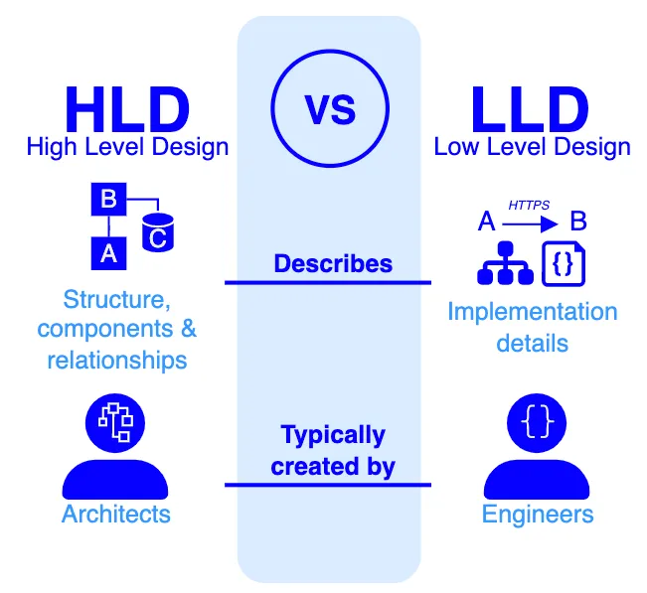

Slide 10
Let’s look at HLD first

Slide 11
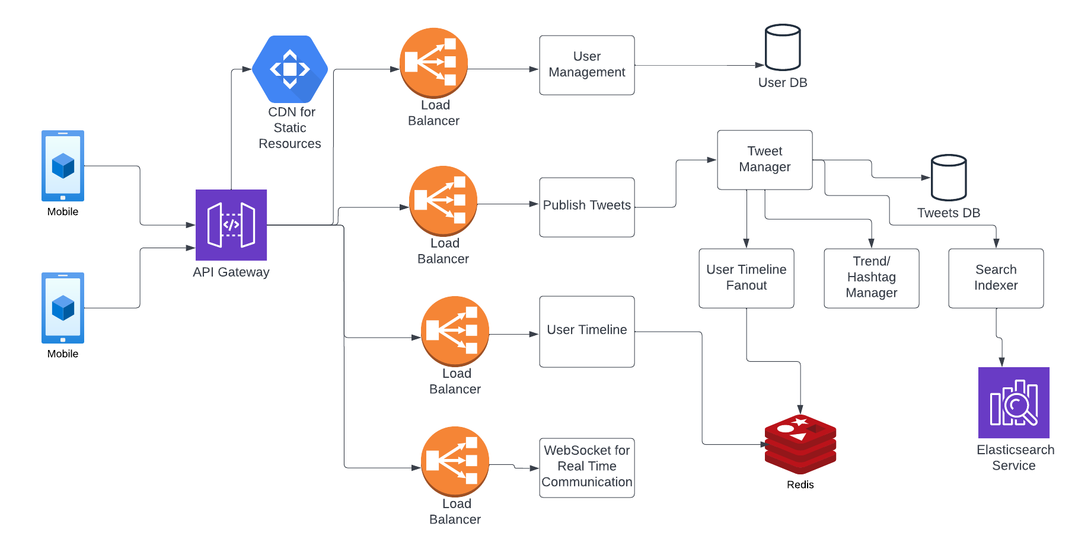
High Level Design
A high-level design (HLD) document serves as a blueprint — outlining the overall structure, components, and relationships of a system, platform or project. Its purpose is to provide a clear and concise overview of the system’s architecture, key functionality, interfaces, and major design decisions.

Slide 12
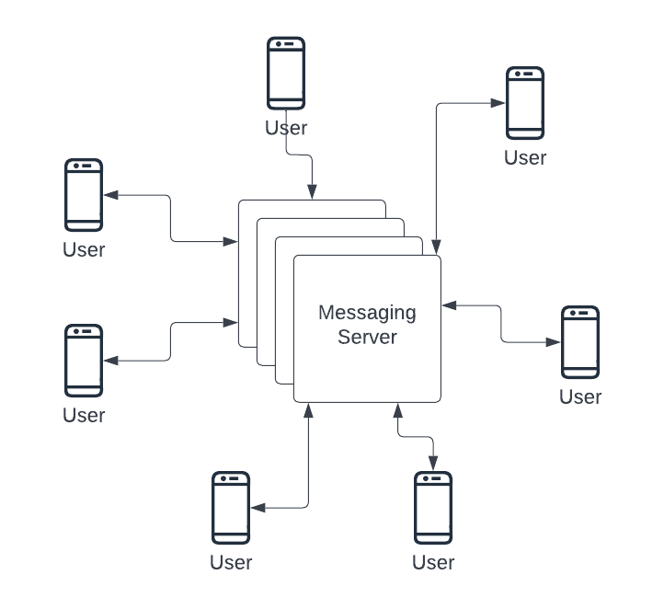
Example - Design Whatsapp
Requirements …
Functional
User should be able to create and manage an account
User should be able to send a message to contact
User should be able to send a message to a group
User should be able to send a media message (image/ video)
Message Received and Message Read receipts to sender
Voice Calling (Not covering here)
Non-Functional
Encryption
Scalability
Availability
`

Slide 13
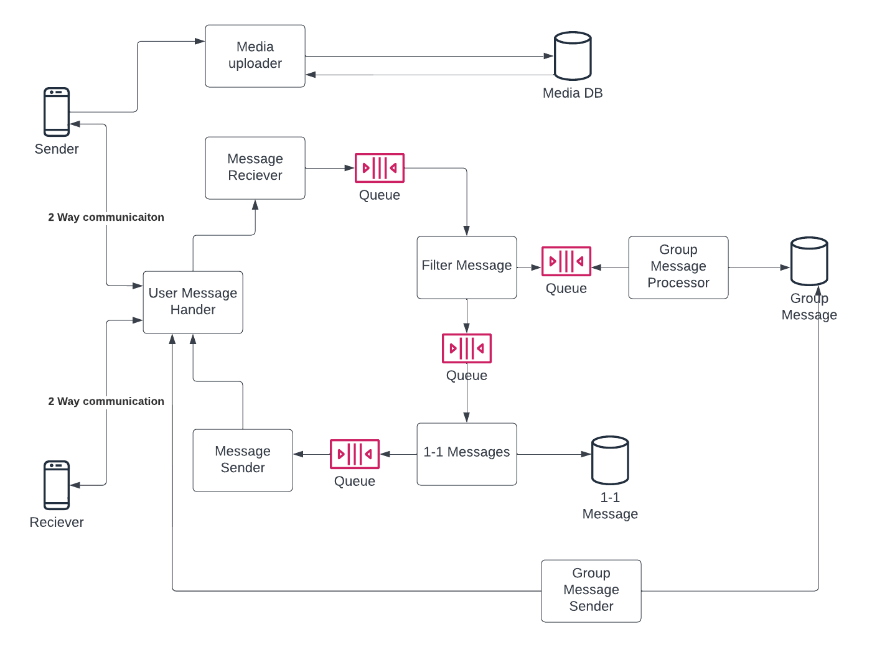
1 Level Deeper

Slide 14
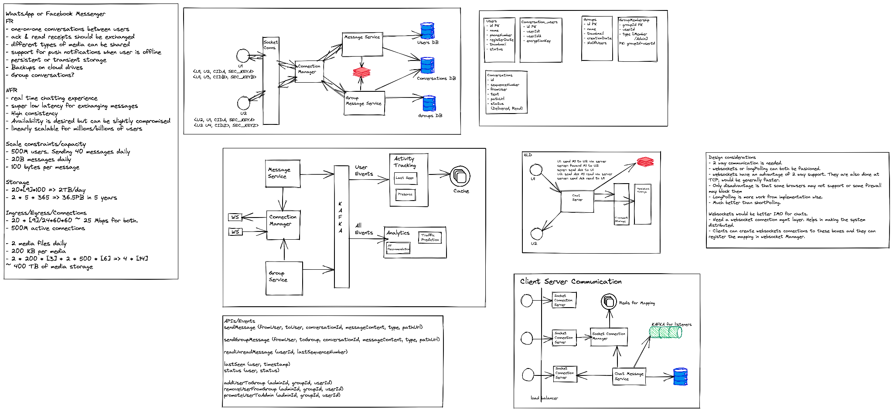
What you think in the HLD Interviews…

Slide 15
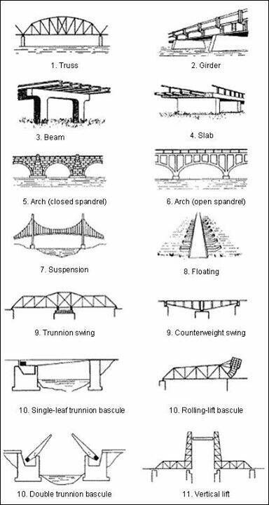
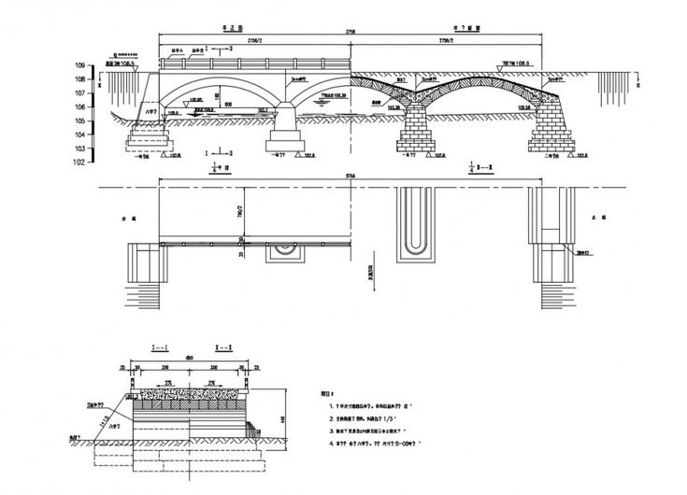
HLD is Planning the Pieces … What goes where.

Slide 16
Let’s look at LLD now!

Slide 17
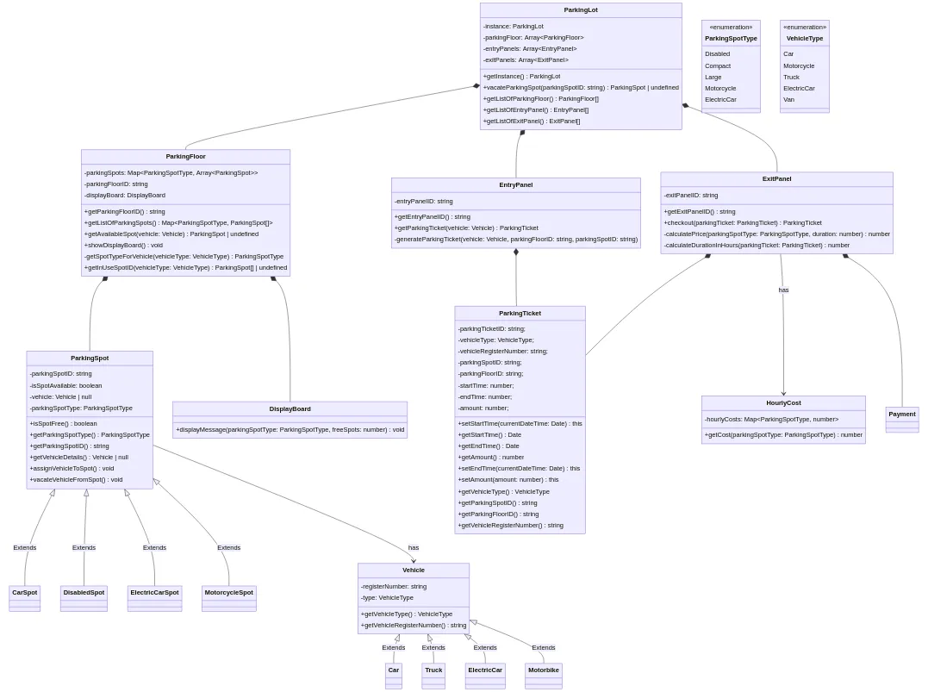
Low Level Design (LLD)
A low-level design document/s provides detailed specifications for the implementation of a system, platform or project. It covers technical details such as physical data models, integration/data flows, algorithms and platform configurations.

Slide 18
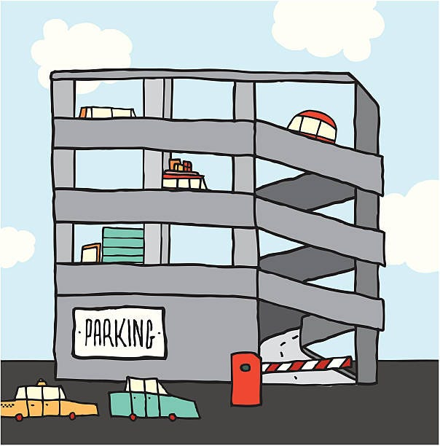
Example - Design a Parking Lot
Understand the system requirements and constraints.
Identify the objects in a system.
Establish relationships between objects, and
Implement based on Object-Oriented principles

Slide 19
Look at requirements :
- The parking lot should have multiple floors where customers can park their cars.
- The parking lot should have multiple entry and exit points.
- Customers can collect a parking ticket from the entry points and can pay the parking fee at the exit points to the parking attendant or automated exit panel
- Customers can pay via both cash and credit cards.
- The system should not allow more vehicles than the maximum capacity of the parking lot. If the parking is full, the system should be able to show a message at the entrance panel and on the parking display board on the ground floor.
- Each parking floor will have many parking spots. The system should support multiple types of parking spots such as Compact, Large, Disabled, Motorcycle, etc.
- The system should support parking for different types of vehicles like car, truck, van, motorcycle, etc.
- Each parking floor should have a display board showing any free parking spot for each spot type.
- The system should support a per-hour parking fee model. For example, customers have to pay some amount based on the Vehicle type.
- Admins should be able to add parking floors and parking spot.

Slide 20
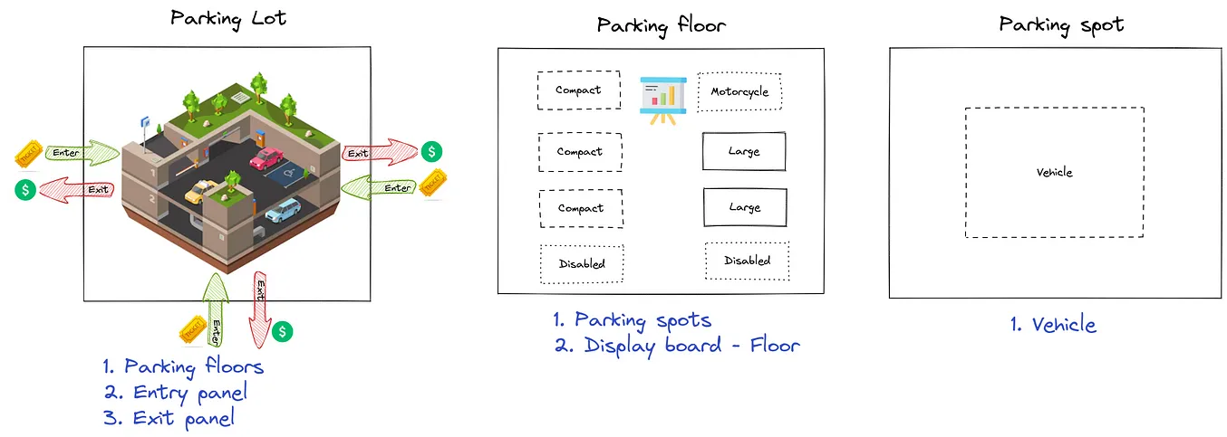
Break Top-Down

Slide 21
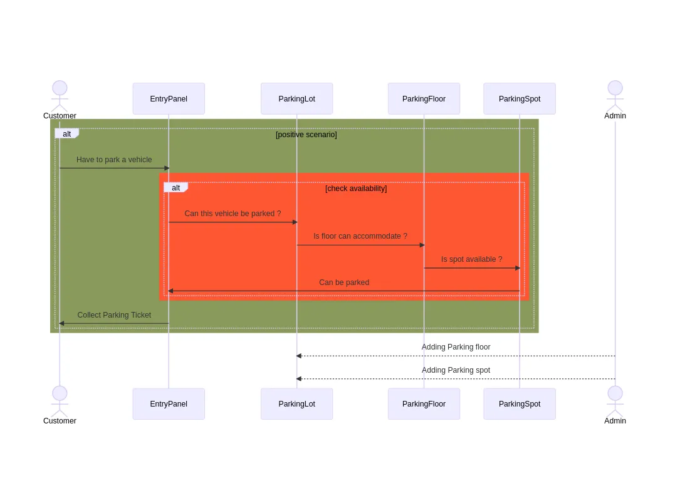
Think about overall Behavior

Slide 22
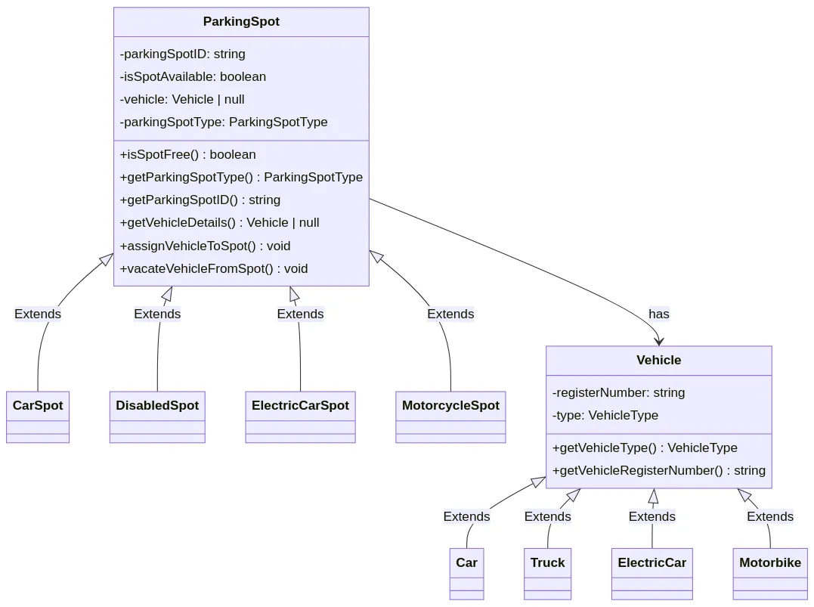
Implement Bottom-Up

Slide 23
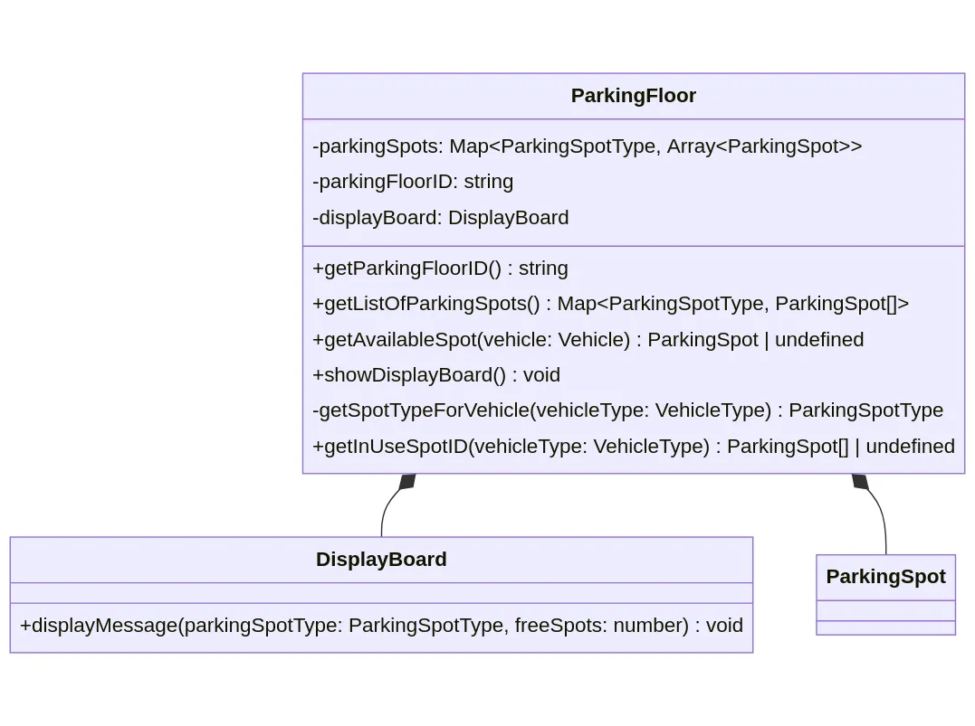
Implement Bottom-Up

Slide 24
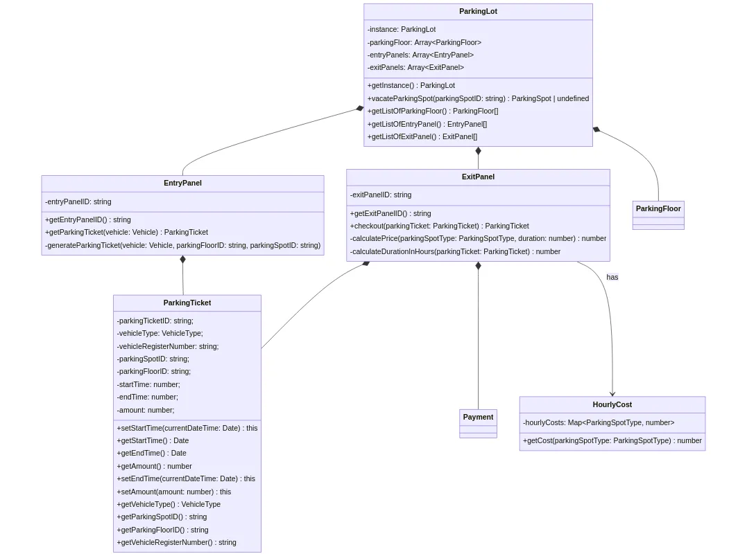
Implement Bottom-Up

Slide 25
Final Code
Architecture

Slide 26
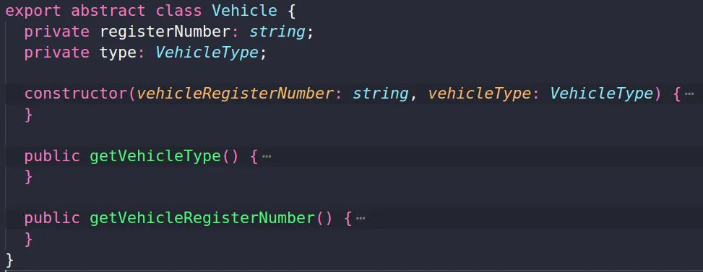
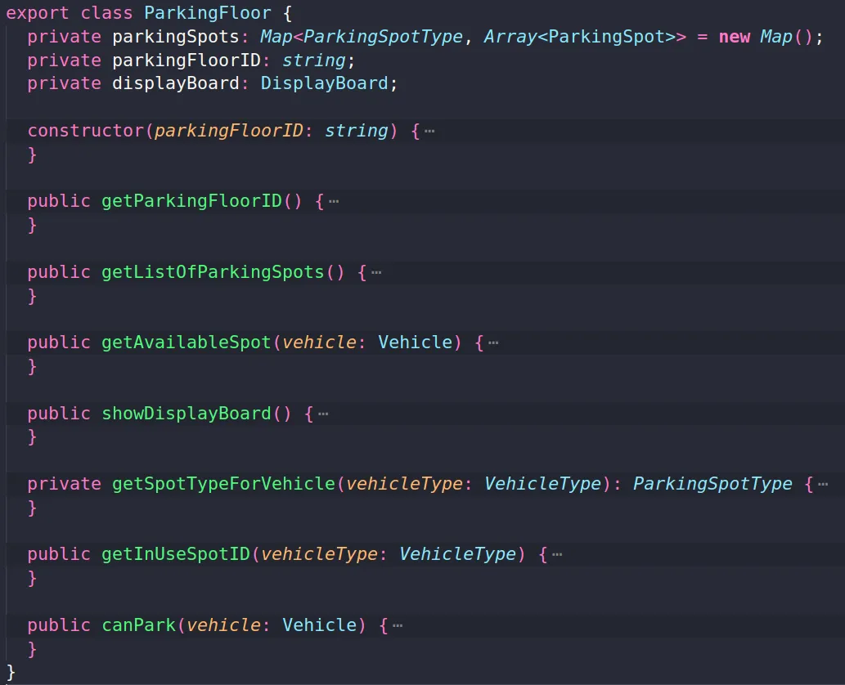
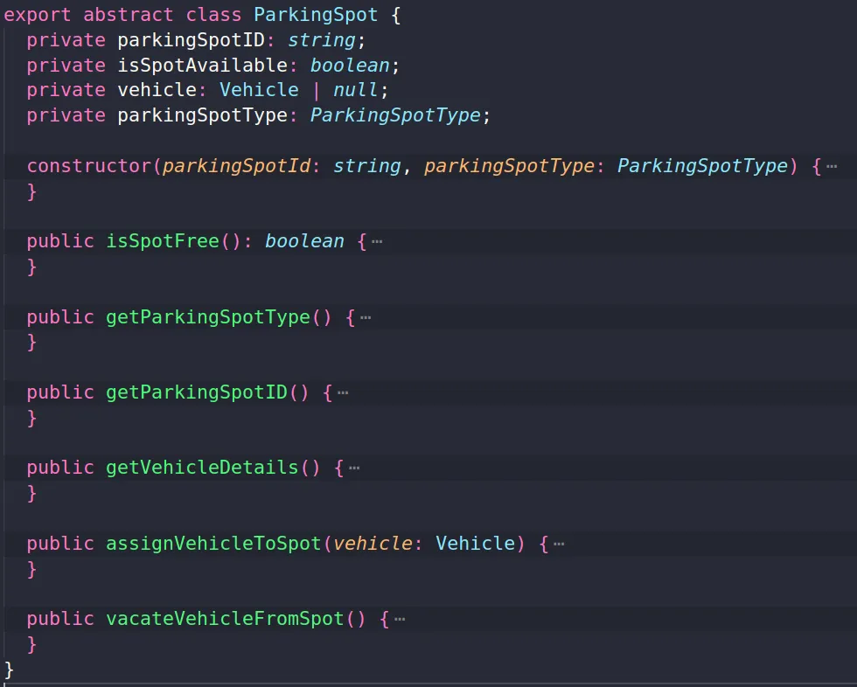
The Real code…

Slide 27
The Real code…
The ParkingLot class serves as the system's entry point.
The ParkingLot class is declared using the singleton pattern, which limits class initialization to ensure that only one instance of the class can be created.

Slide 28

LLD is actually building the Bridge!

Slide 29
When do you need it actually??
Junior Engineer
Mid-Level Engineer
Senior Engineer
Staff Engineer
0 years
2 years
5 years
8-10 years

Slide 30
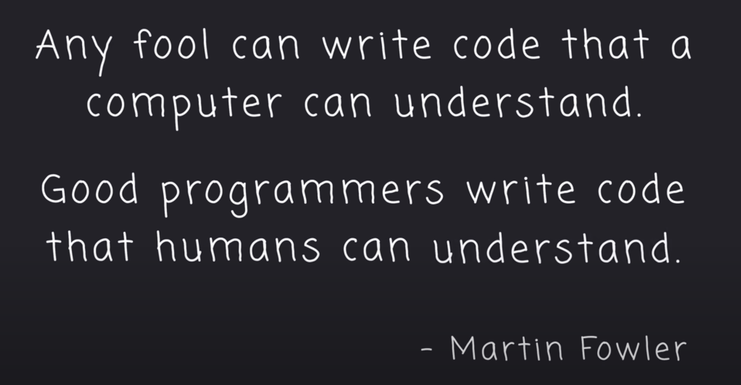

Slide 31
OOPS fundamentals

Slide 32
Classes and Objects … which i hope you already know …
CLASS
Classes have the following characteristics-
Name(What is it), Attributes(How the objects are described), Operations(What can the objects do).
OBJECT
An object is an instance of a class i.e. specific occurrence of a class.
Class is a logical Construct while an object has physical reality i.e. an object occupies space in memory.
Class is the blueprint or detailed description of how the object will be.It is like a Template for an object.
Object is a real world entity in object oriented environment that may have physical or conceptual existence.

Slide 33
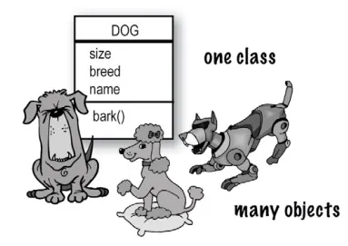
Mental Picture that i have in mind …

Slide 34
What is Object Oriented Programming ??
OOP is considered the crown jewel of computer science. Essentially for building complex applications, it is considered as the ultimate solution for code organization. So what is this OOP? thing trending,
Object-oriented programming (or OOP) is a paradigm or pattern of programming where the solution to a programming problem is modelled as a collection of collaborating objects. It is most suitable for managing large, complex problems.

Slide 35
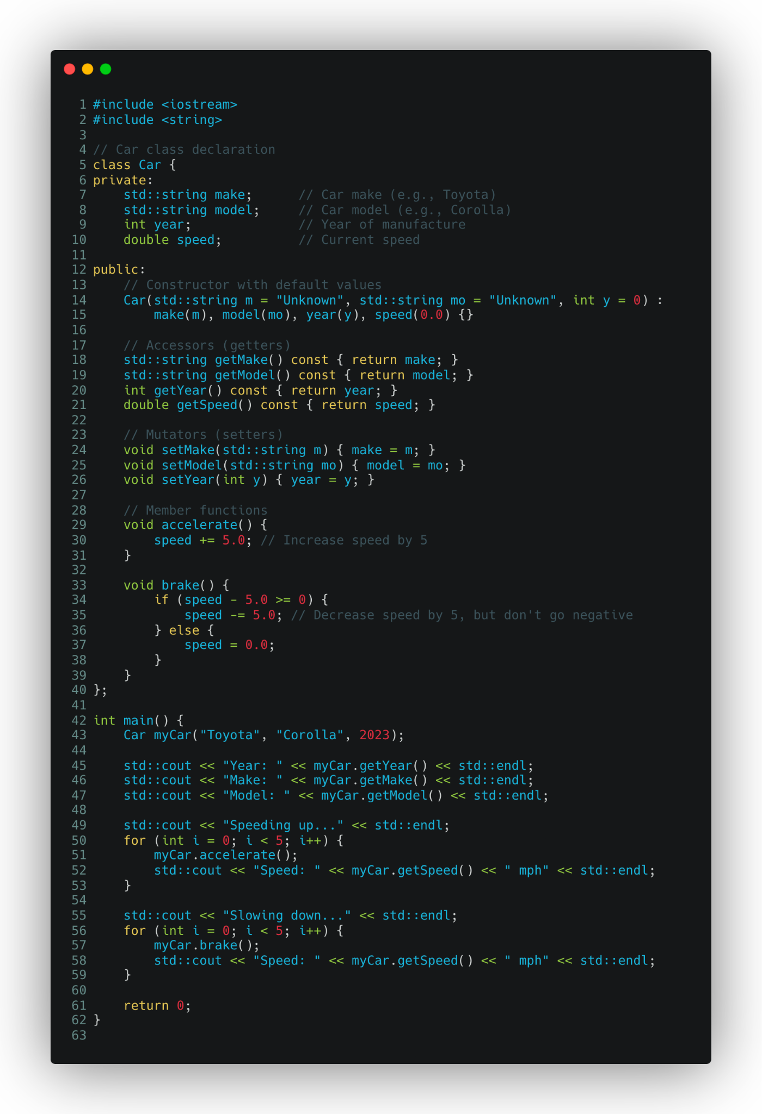
Real Code Examples

Slide 36
Real Code Examples

Slide 37
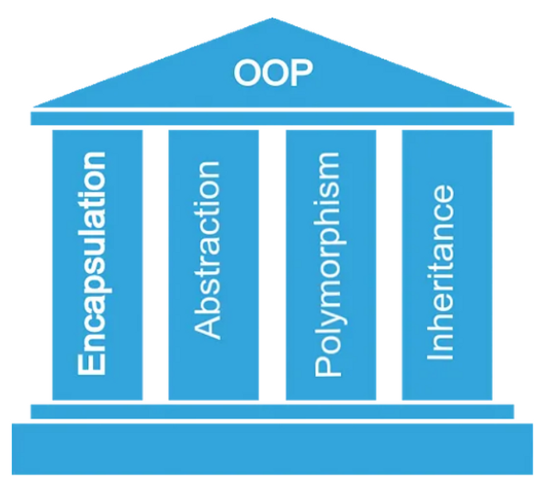
The main 4 Pillars
Abstraction
Encapsulation
Inheritance
Polymorphism

Slide 38
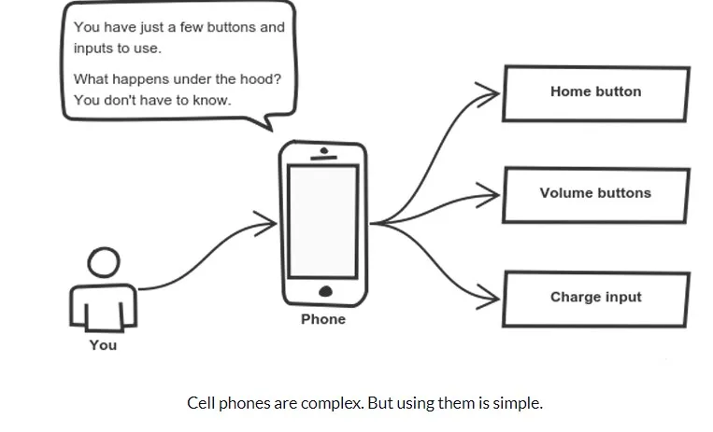
Abstraction
Abstraction is a concept that aims to expose only high-level details of functionalities for the users and hiding all the background/implementation details.

Slide 39
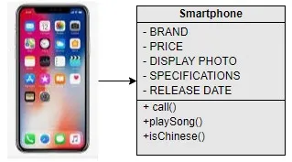
Encapsulation
Encapsulation leads to data hiding.
We use access specifiers to hide the data(properties) and methods. Use of private and public comes under this.
Why it is important to hide variables if we are anyway exposing them through methods? This is a very common question and here’s the explanation

Slide 40
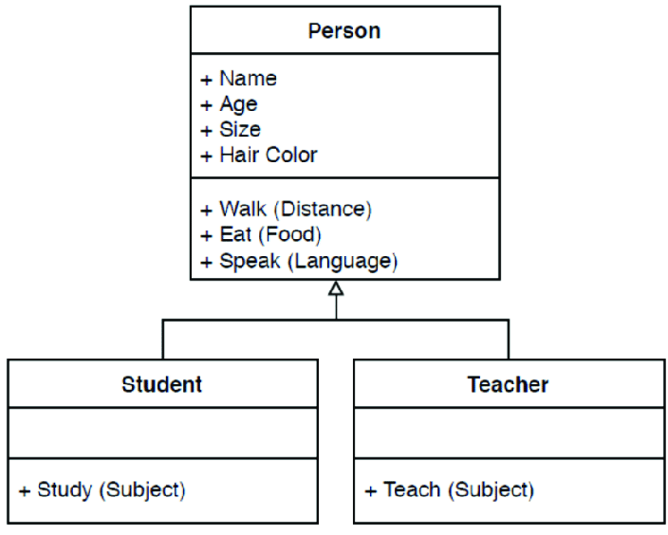
Inheritance
Inheritance describes IS A Relationship.
Example- A Car(derived) is a Vehicle(Base).Corona(derived) is a Virus(Base).
For Bollywood fans-Remember how KRRISH inherited his powers From his father Rohit(Koi mil Gaya)
or if you can relate how Mahendra Bahubali inherited power from Amarendra Bahubali(After katappa killed him…)

Slide 41
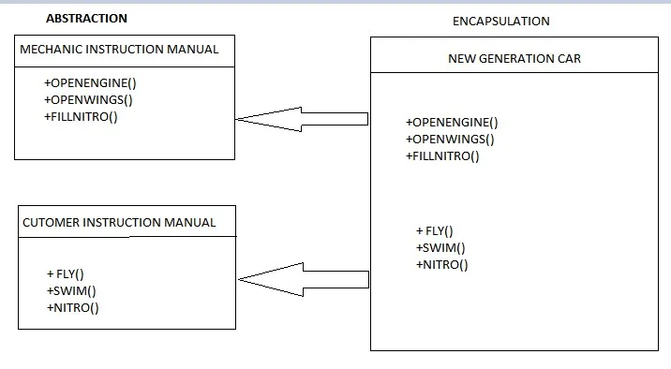
Polymorphism
Polymorphism is the ability to take more than one form by methods and variables.
Polymorphism is achieved in two ways
Method Overriding(Dynamic polymorphism) — Child class implements a method that is already present in the parent class, resulting in the child method being invoked.
Method Overloading ( Static polymorphism) — Writing multiple methods with the same name but with different sets of parameters (or order of parameters) so that the appropriate method gets invoked based on the parameters passed.

Slide 42
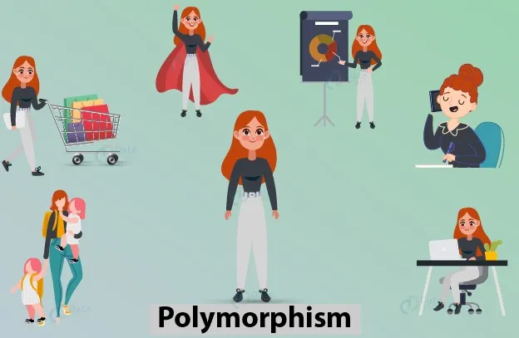

Slide 43
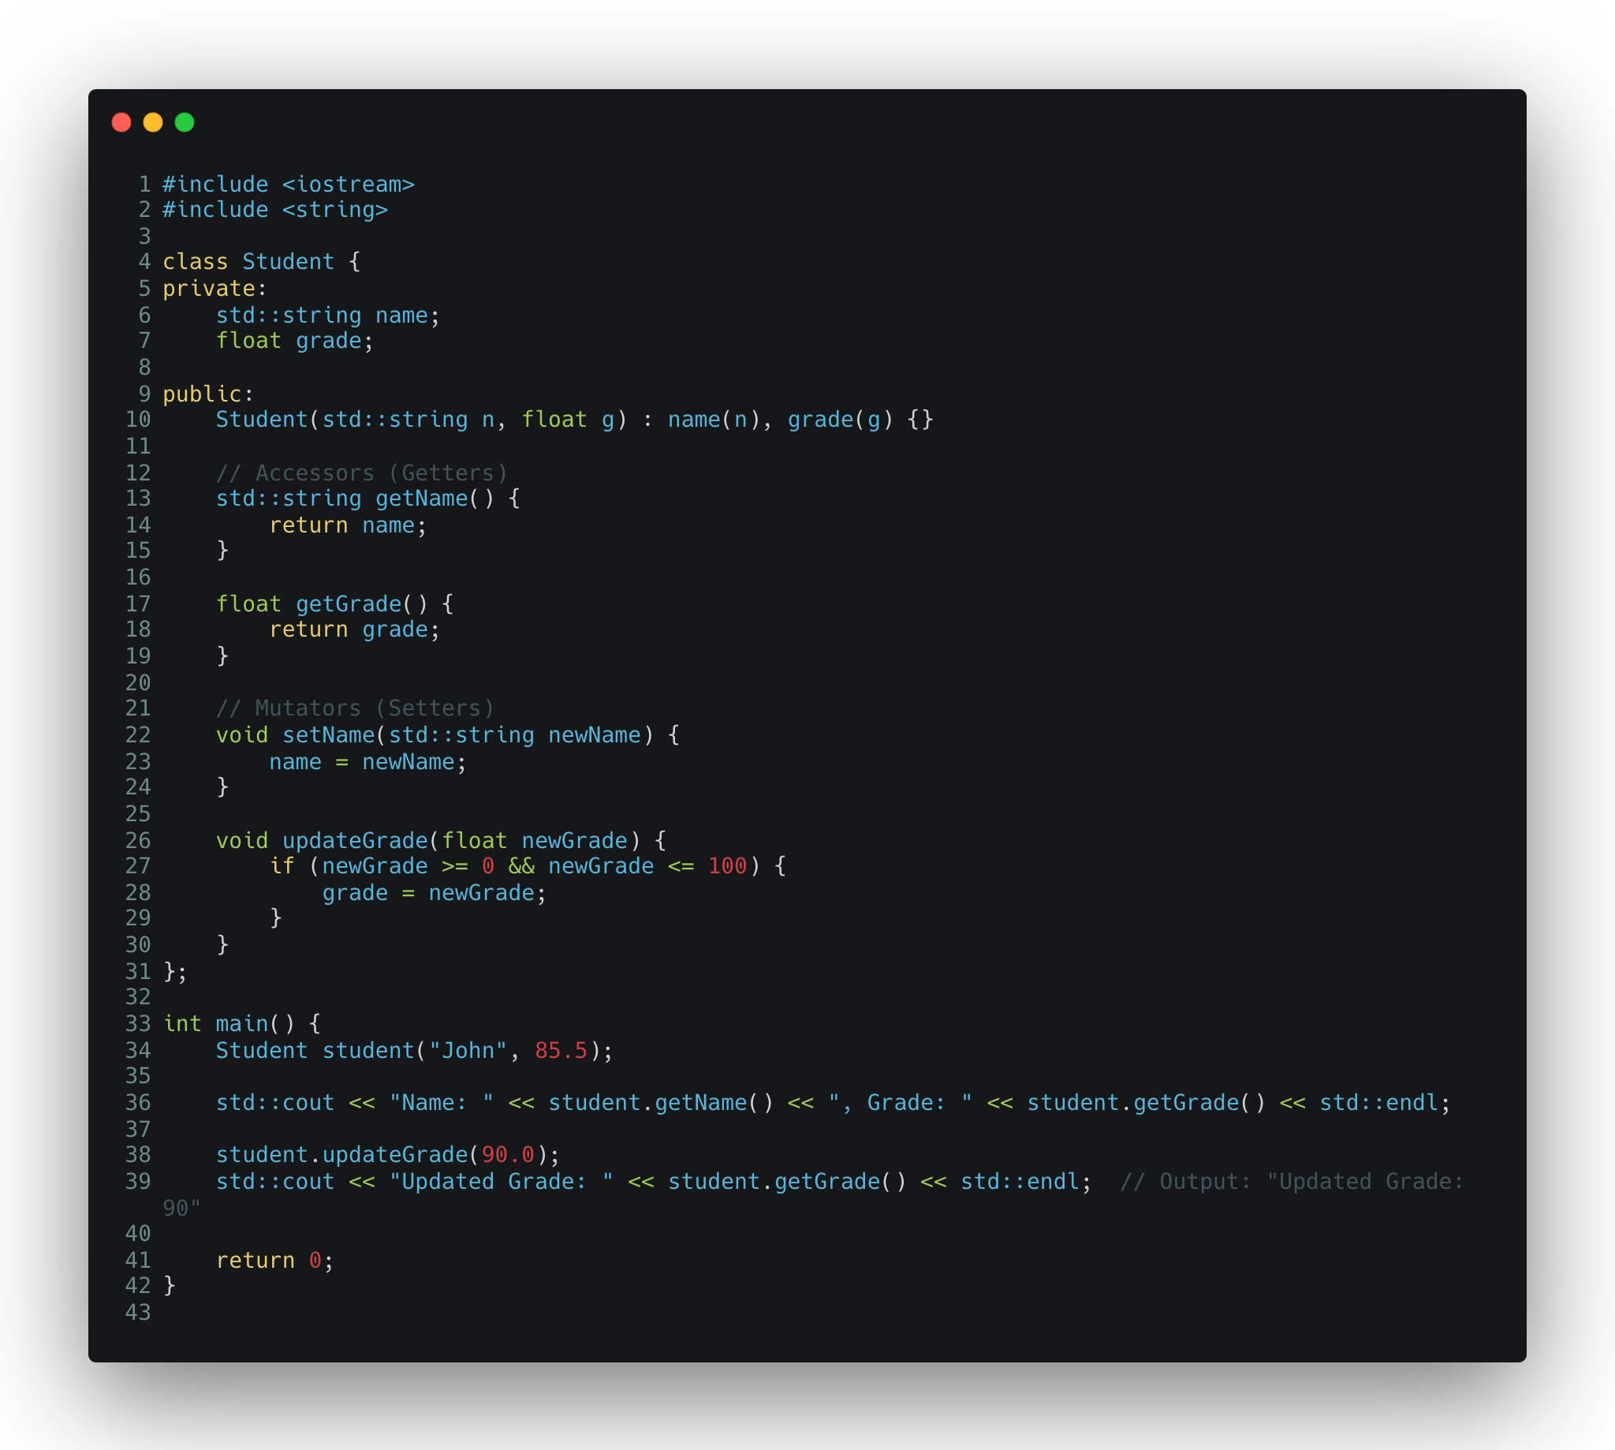

Slide 44
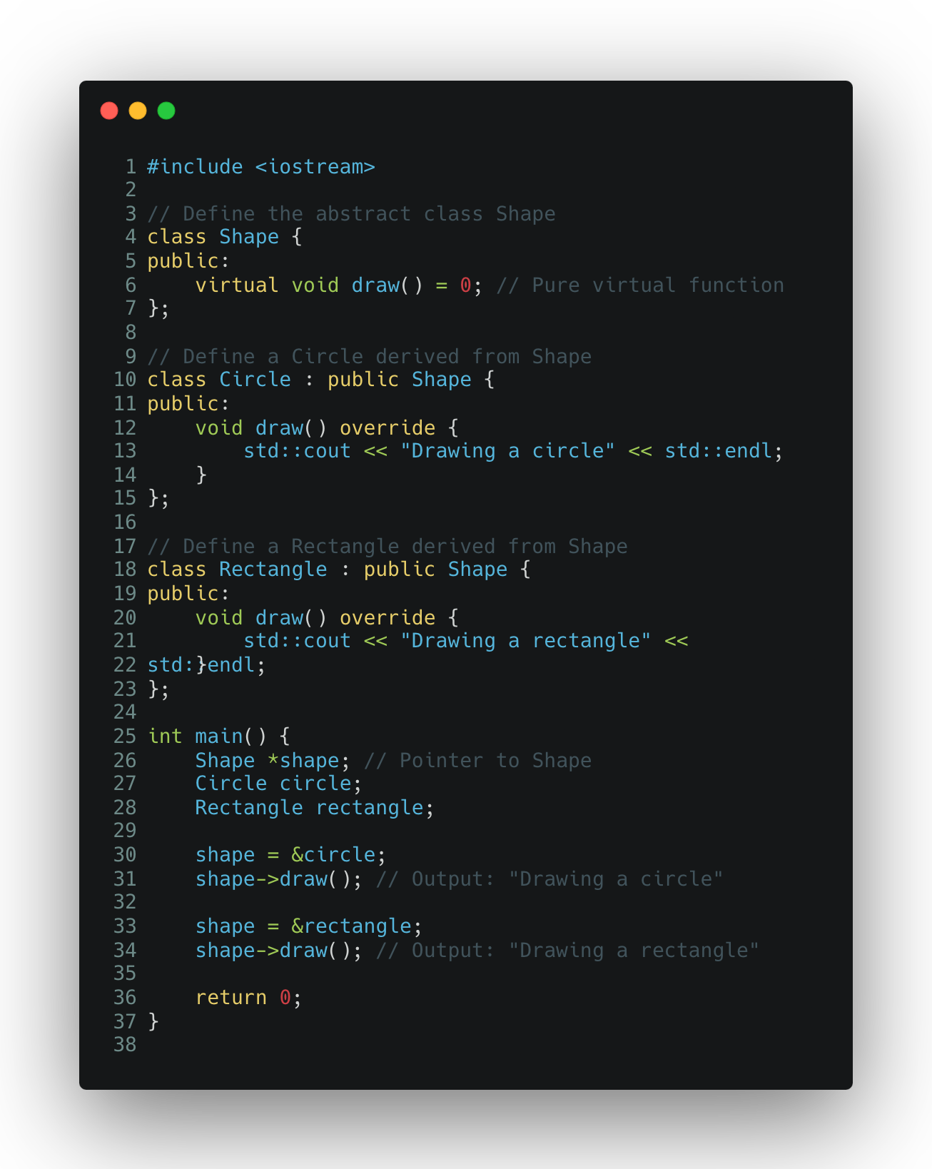

Slide 45
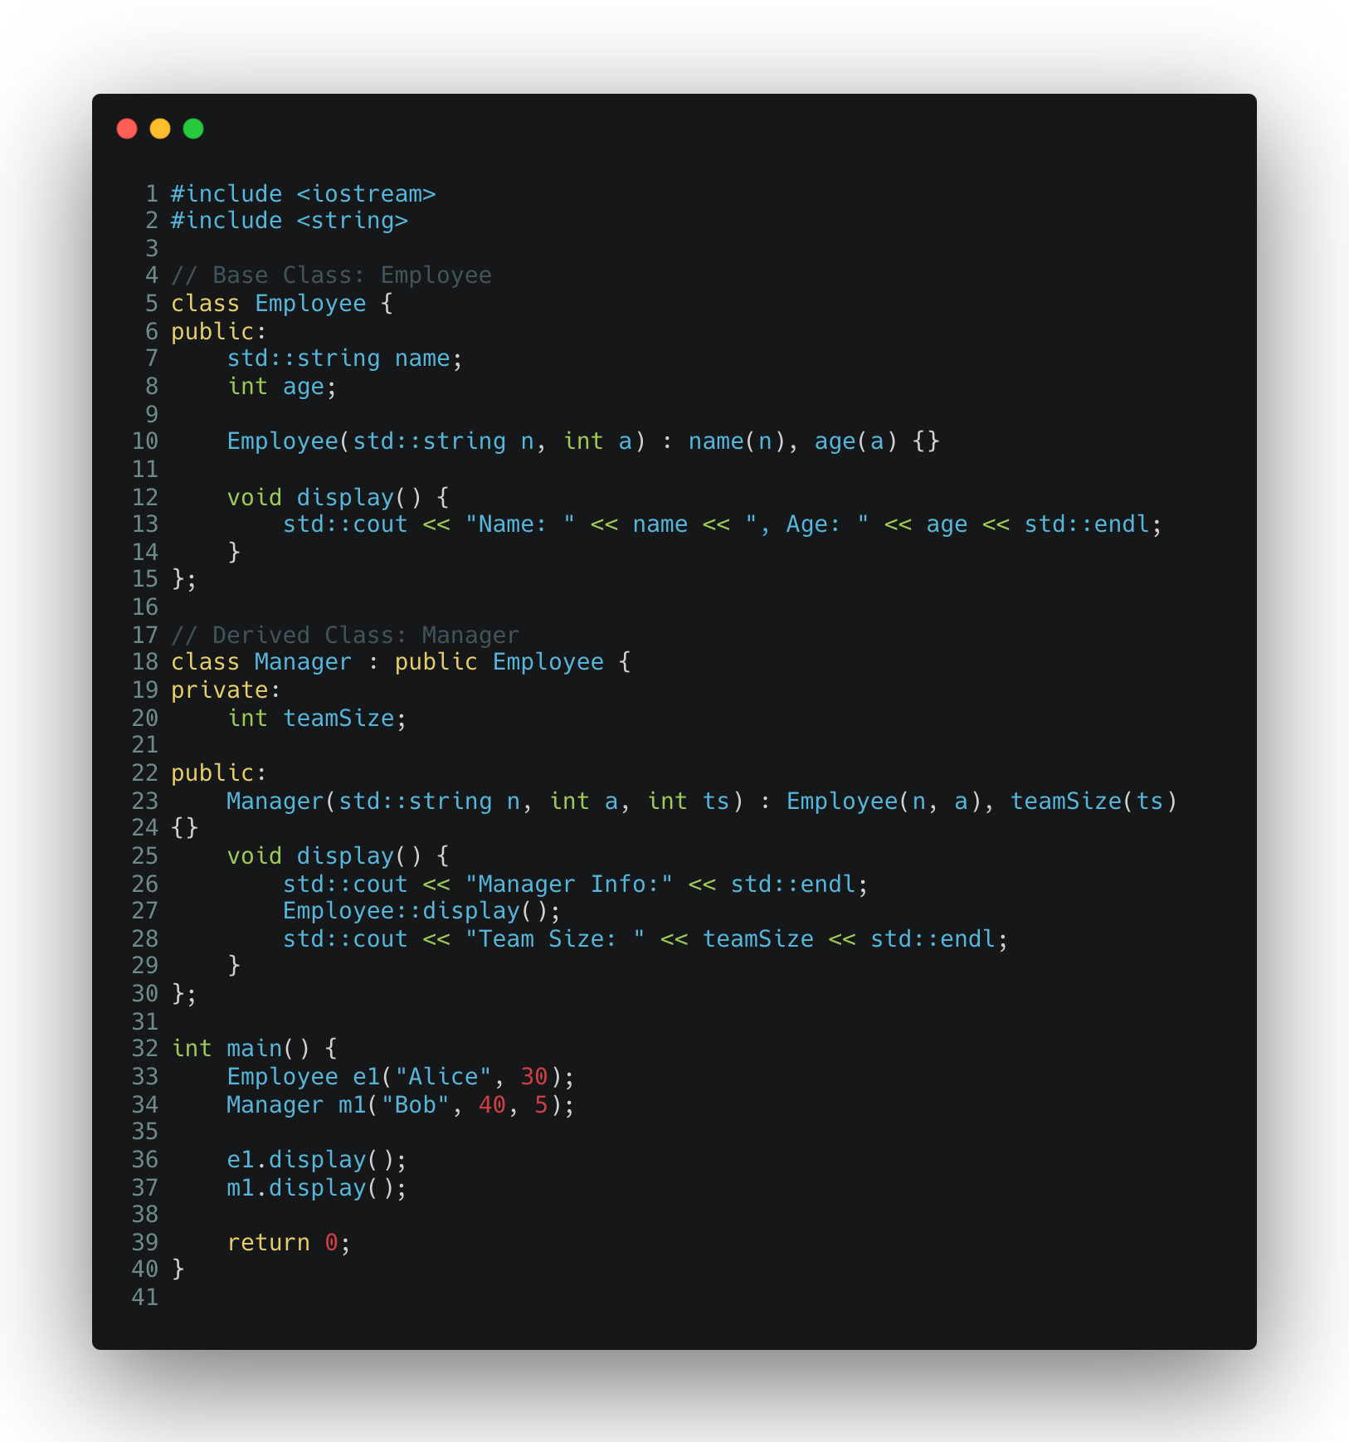

Slide 46
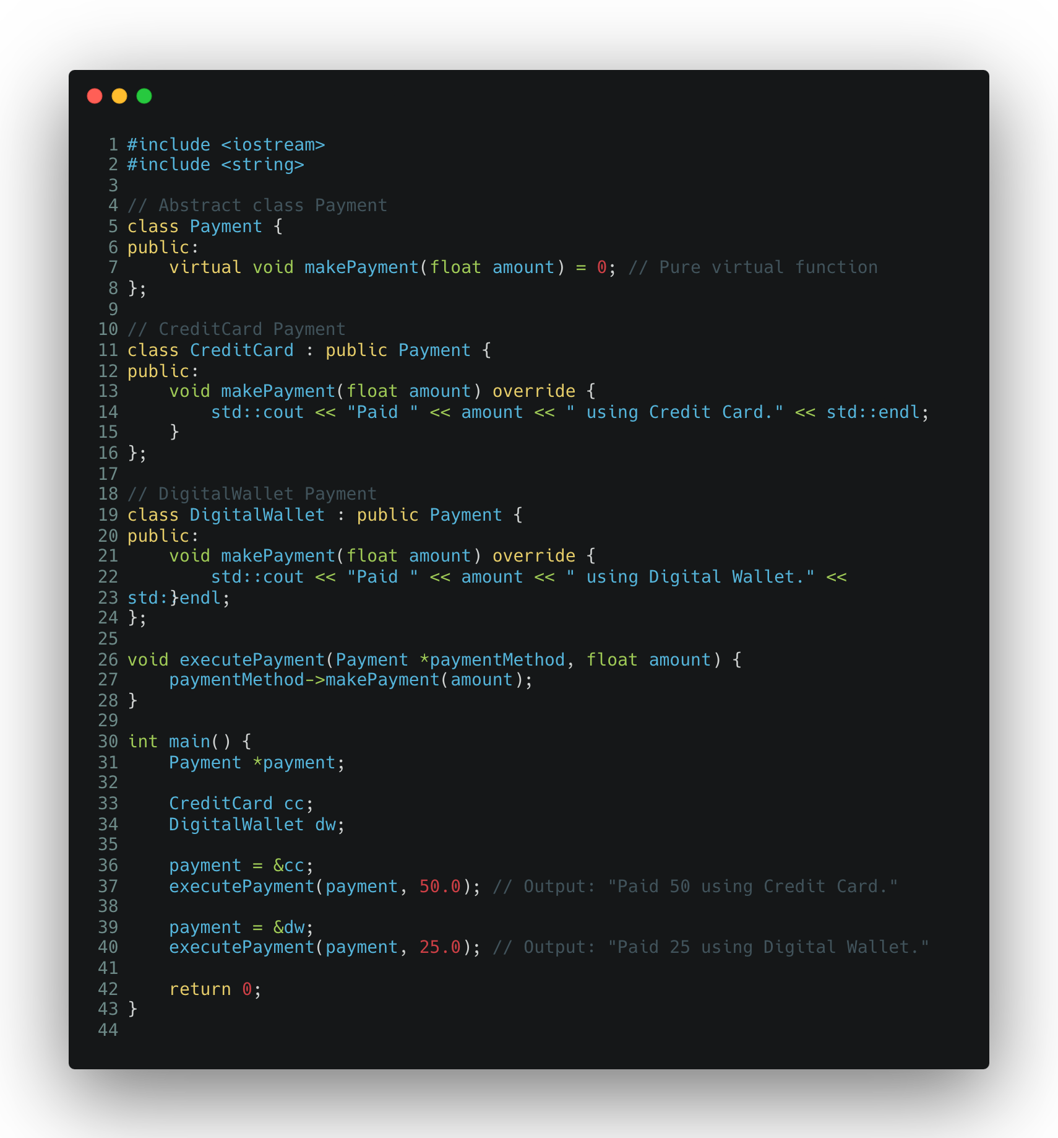

Slide 47
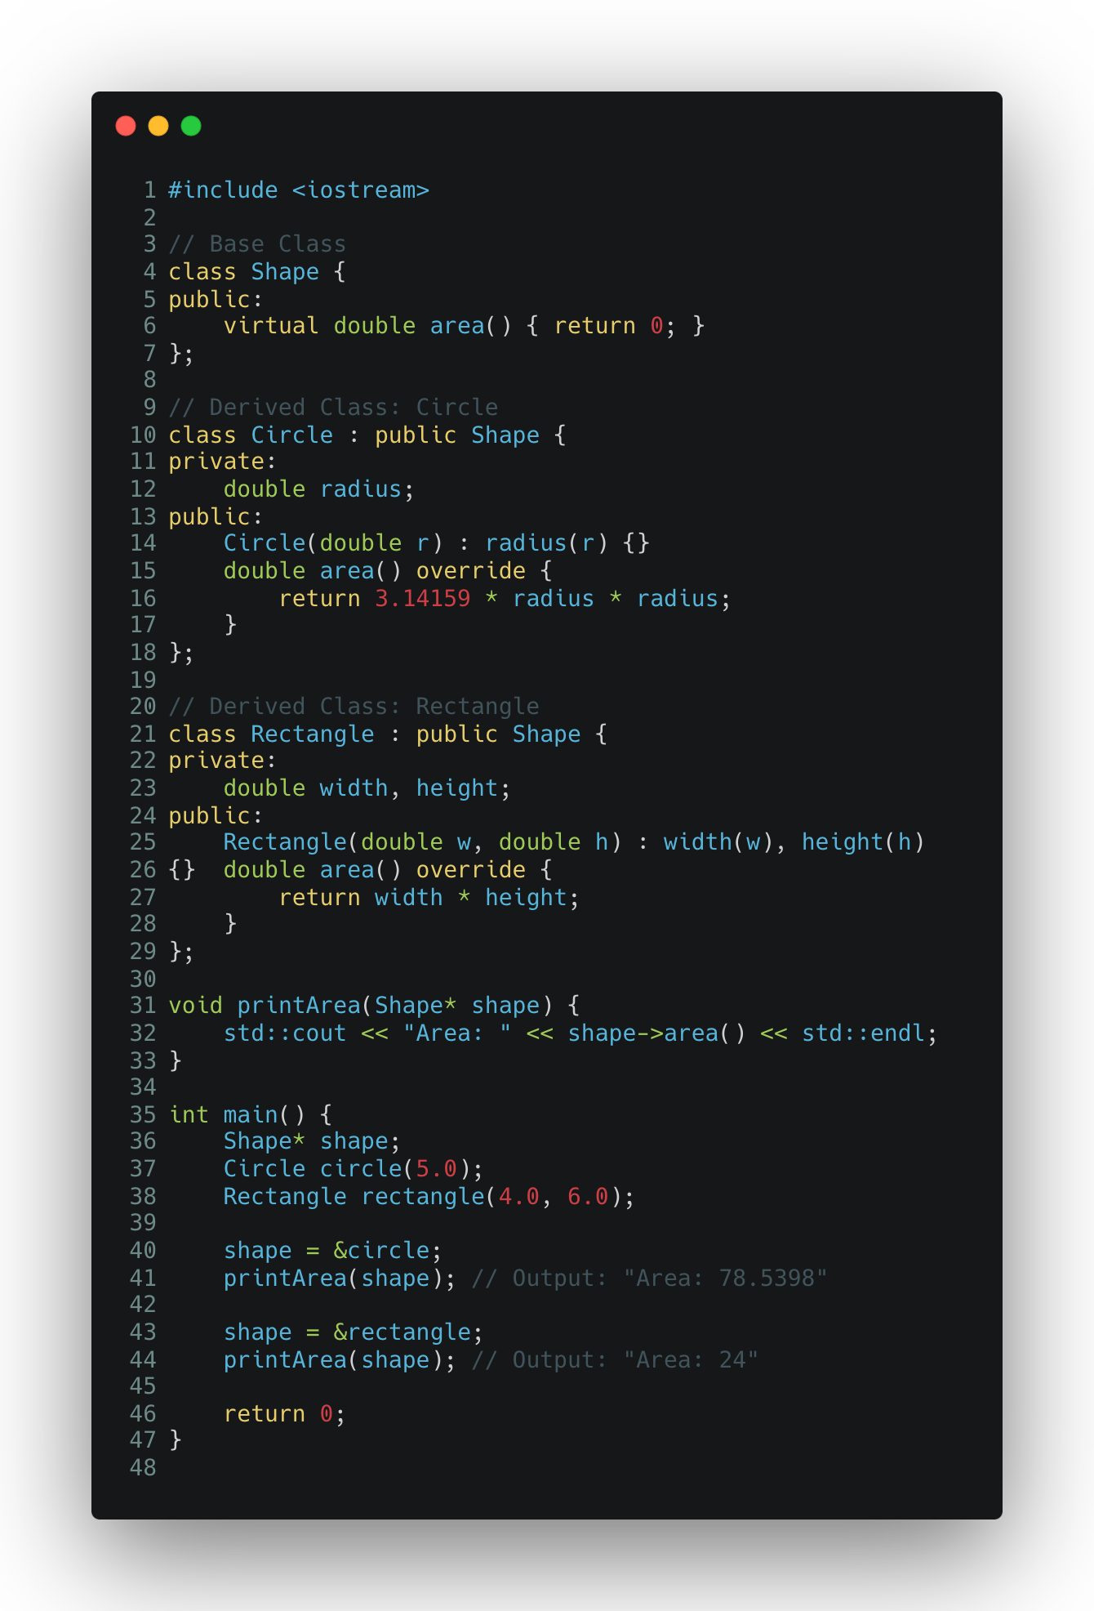

Slide 48
These are just basics … and that’s all what is needed !!

Slide 49
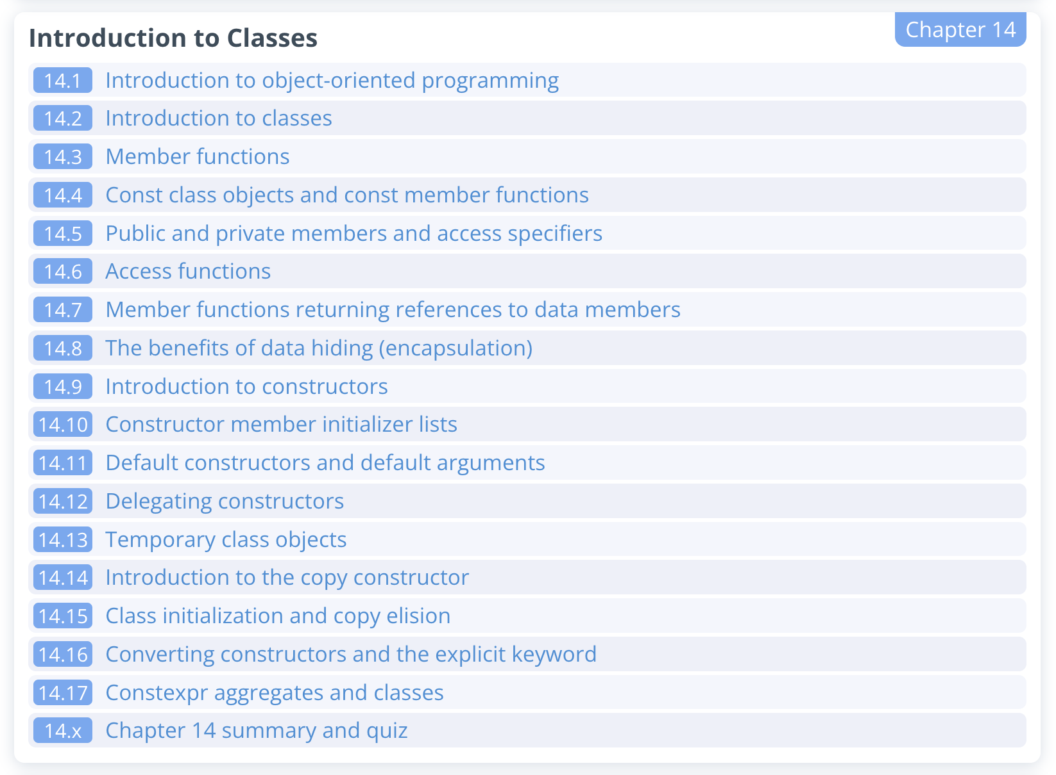
learncpp.com

Slide 50
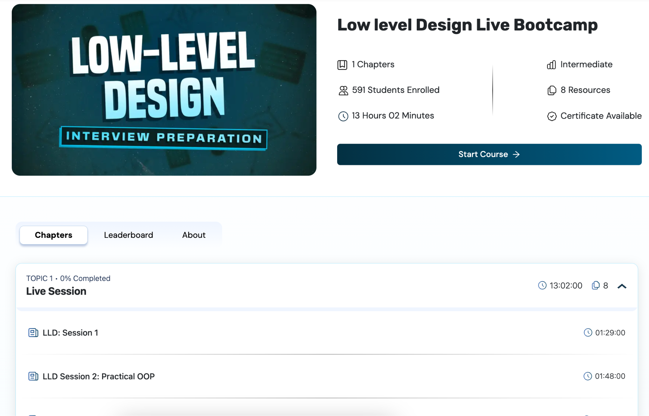
First 4 Lectures… Quite Exhaustive !!

